Slide 1



KIET DATA CENTER
NISHANT SHARMA

Slide 2


KIET DATA CENTER
Nishant Sharma
2100290140098
Section :- B
2022-23
Project Supervisor:- Dr . Sangeeta Arora

Slide 3
Introduction
Requirement and Specification
Scope of the project
Modules of the system
KDC Screens
Future Enhancement
Project Outcome
Conclusion

Slide 4
INTRODUCTION
This project aims to provide a solution to the challenges faced by colleges in managing their databases. The project will focus on the efficient management of college and department databases, enabling the institution to manage its various functions effectively. The system will store and organize data related to student certificates, academic details, and various events held by the college with participating students.
The system will also keep track of the account and human resources departments, ensuring that all operations are integrated seamlessly. Additionally, it will track students who have been placed in various organizations, allowing the college to monitor their progress after they leave the institution.
For a given registrar / staff / student (Technical / Non-technical) the Administrator creates login-id & password, using these registrar/ staff / students (Technical / Non-technical) can access the system to either upload or download some information from the database.
Overall, the implementation of a comprehensive and efficient database management system will help the college to manage its various departments and functions more efficiently. This will ultimately enhance the institution's reputation and provide better educational opportunities to its students.

Slide 5
Requirement and Specification
Monitoring Information simple and easy: Monitoring information can be made simple and easy using a KIET data center. This system provides a centralized platform for storing and managing data, making it easy to access, update, and analyse information.
Data Organization and Structure: Define the structure and organization of the database, including tables, fields, and relationships between different entities. Determine the data models that best represent the college's requirements, such as entity-relationship models or relational database models.
Minimize Paperwork: This system can help minimize paperwork by providing a digital platform for storing and managing data. This eliminates the need for physical paper files and reduces the amount of paperwork required to manage the data.

Slide 6
Requirement and Specification
System Overview: Provide an overview of the college database management system, describing its purpose, objectives, and intended users. Explain how the system will benefit the college and improve administrative processes.
Functional Requirements: Define the specific functionalities and features the system should include. This may include student information management, course and curriculum management, admissions and enrollment processes, grading and transcript generation, reporting and analytics capabilities, and communication tools.
Data Requirements: Specify the types of data that need to be stored and managed in the system. This includes student information (personal details, enrollment history, grades, etc.), faculty details, course catalogs, and any other relevant data. Define the data fields, data structures, and relationships between different entities.

Slide 7
Scope of the project
Student Information Management: The system should be able to store and manage student information, including personal details, contact information, enrollment history, grades, attendance records, and any other relevant data.
Faculty and Staff Management: The system should provide functionality to store and manage faculty and staff information, including contact details, employment history, teaching assignments, research activities, and performance evaluations.
Reporting and Analytics: The system should offer reporting tools and data analysis capabilities to generate reports on student demographics, enrollment statistics, graduation rates, and other relevant metrics. It should provide insights that help administrators make informed decisions.
Security and Access Control: The system should implement security measures to protect sensitive data. This includes user authentication, role-based access control, and data encryption to ensure that only authorized individuals can access and modify the data.

Slide 8
Modules of the system
Faculty and Staff Management Module: This module manages faculty and staff information, including personal details, employment history, and professional development. It also provides functions for managing payroll, benefits, and performance evaluations.
Financial Management Module: This module manages the college's financial information, including budgets, expenses, and revenue. It also provides functions for managing accounts payable and receivable, financial reporting, and auditing.
6.Human resources: This module would manage the personnel details of the staff members, including their roles, responsibilities, and performance details.
4.Financial Management Module: This module manages the college's financial information, including budgets, expenses, and revenue. It also provides functions for managing accounts payable and receivable, financial reporting, and auditing.

Slide 9
Welcome to KDC(KIET Data Center) Screen

Slide 10
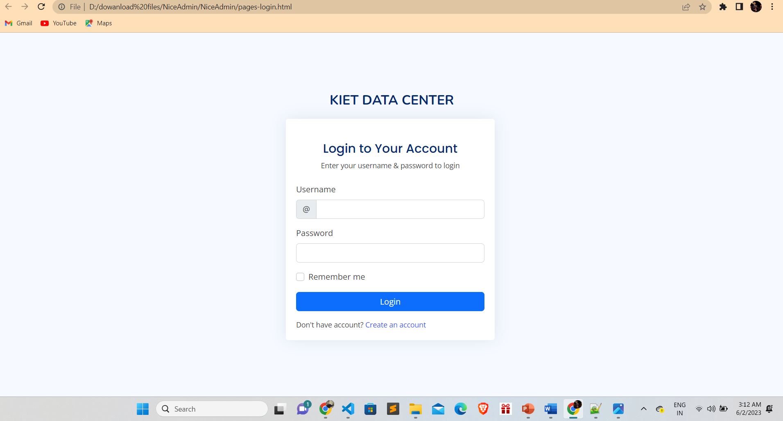
Login

Slide 11
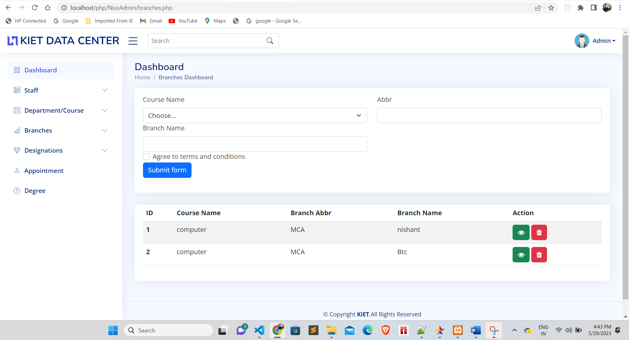
Branches

Slide 12
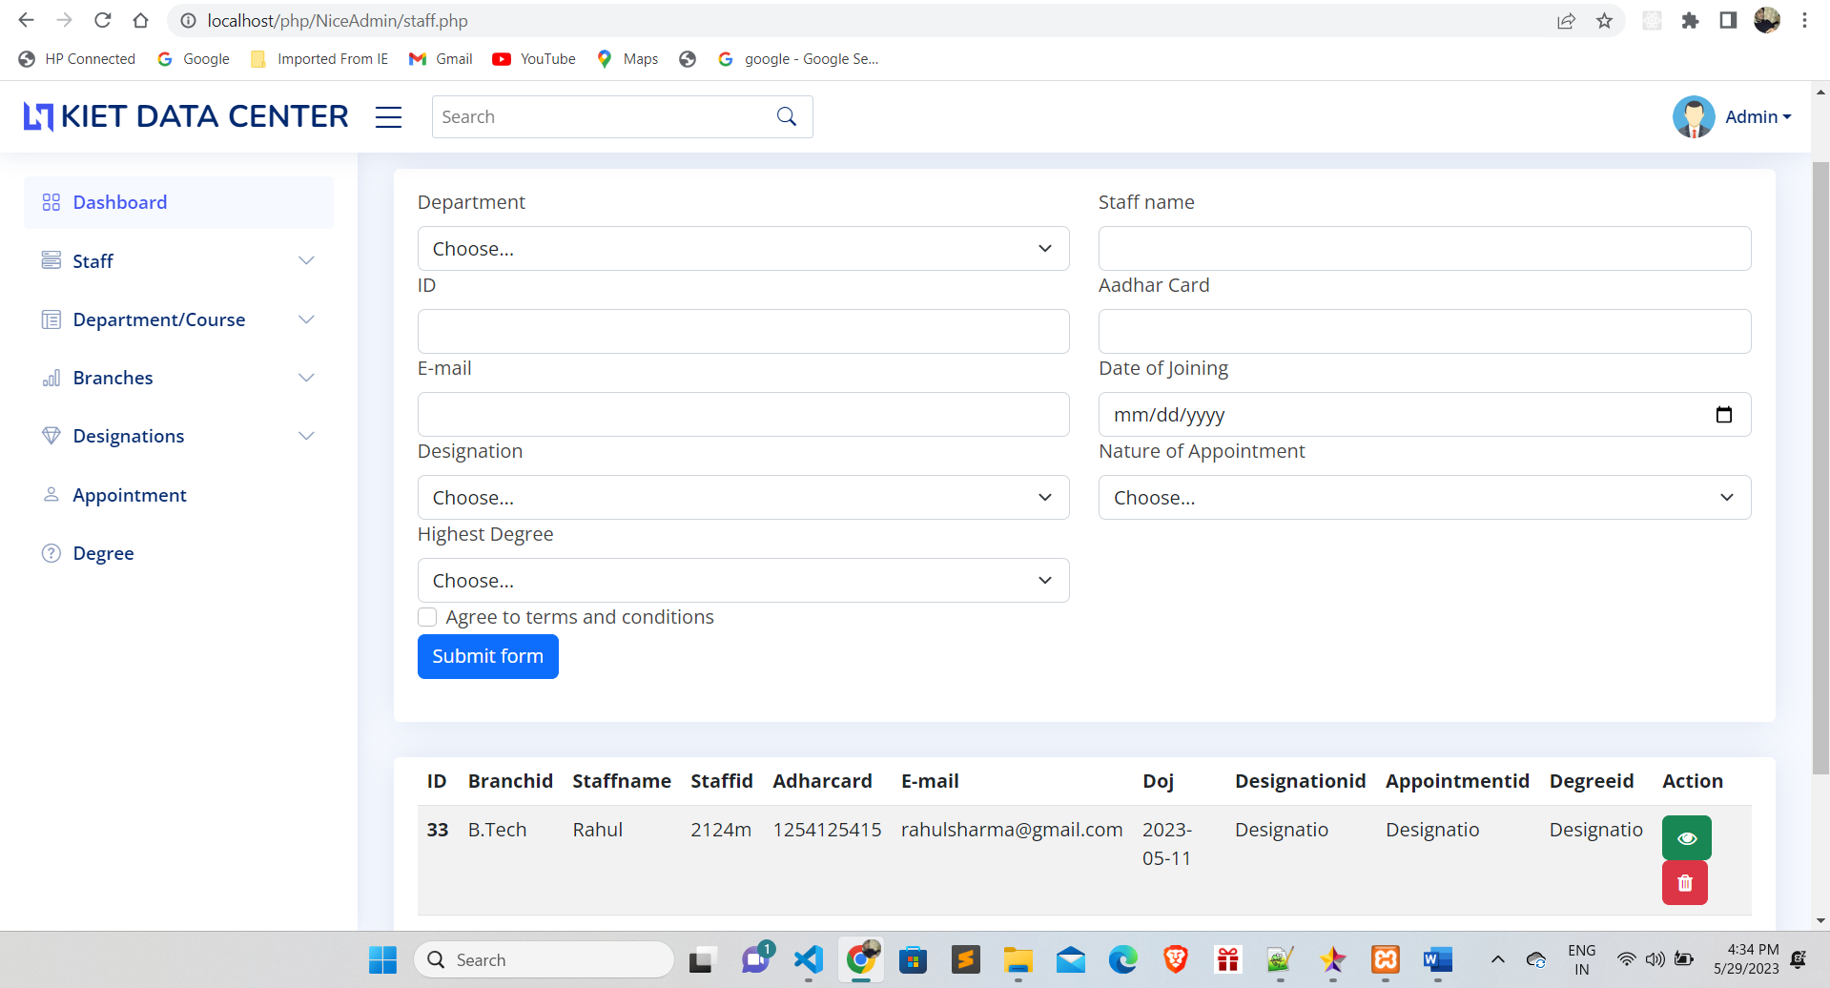
Department

Slide 13
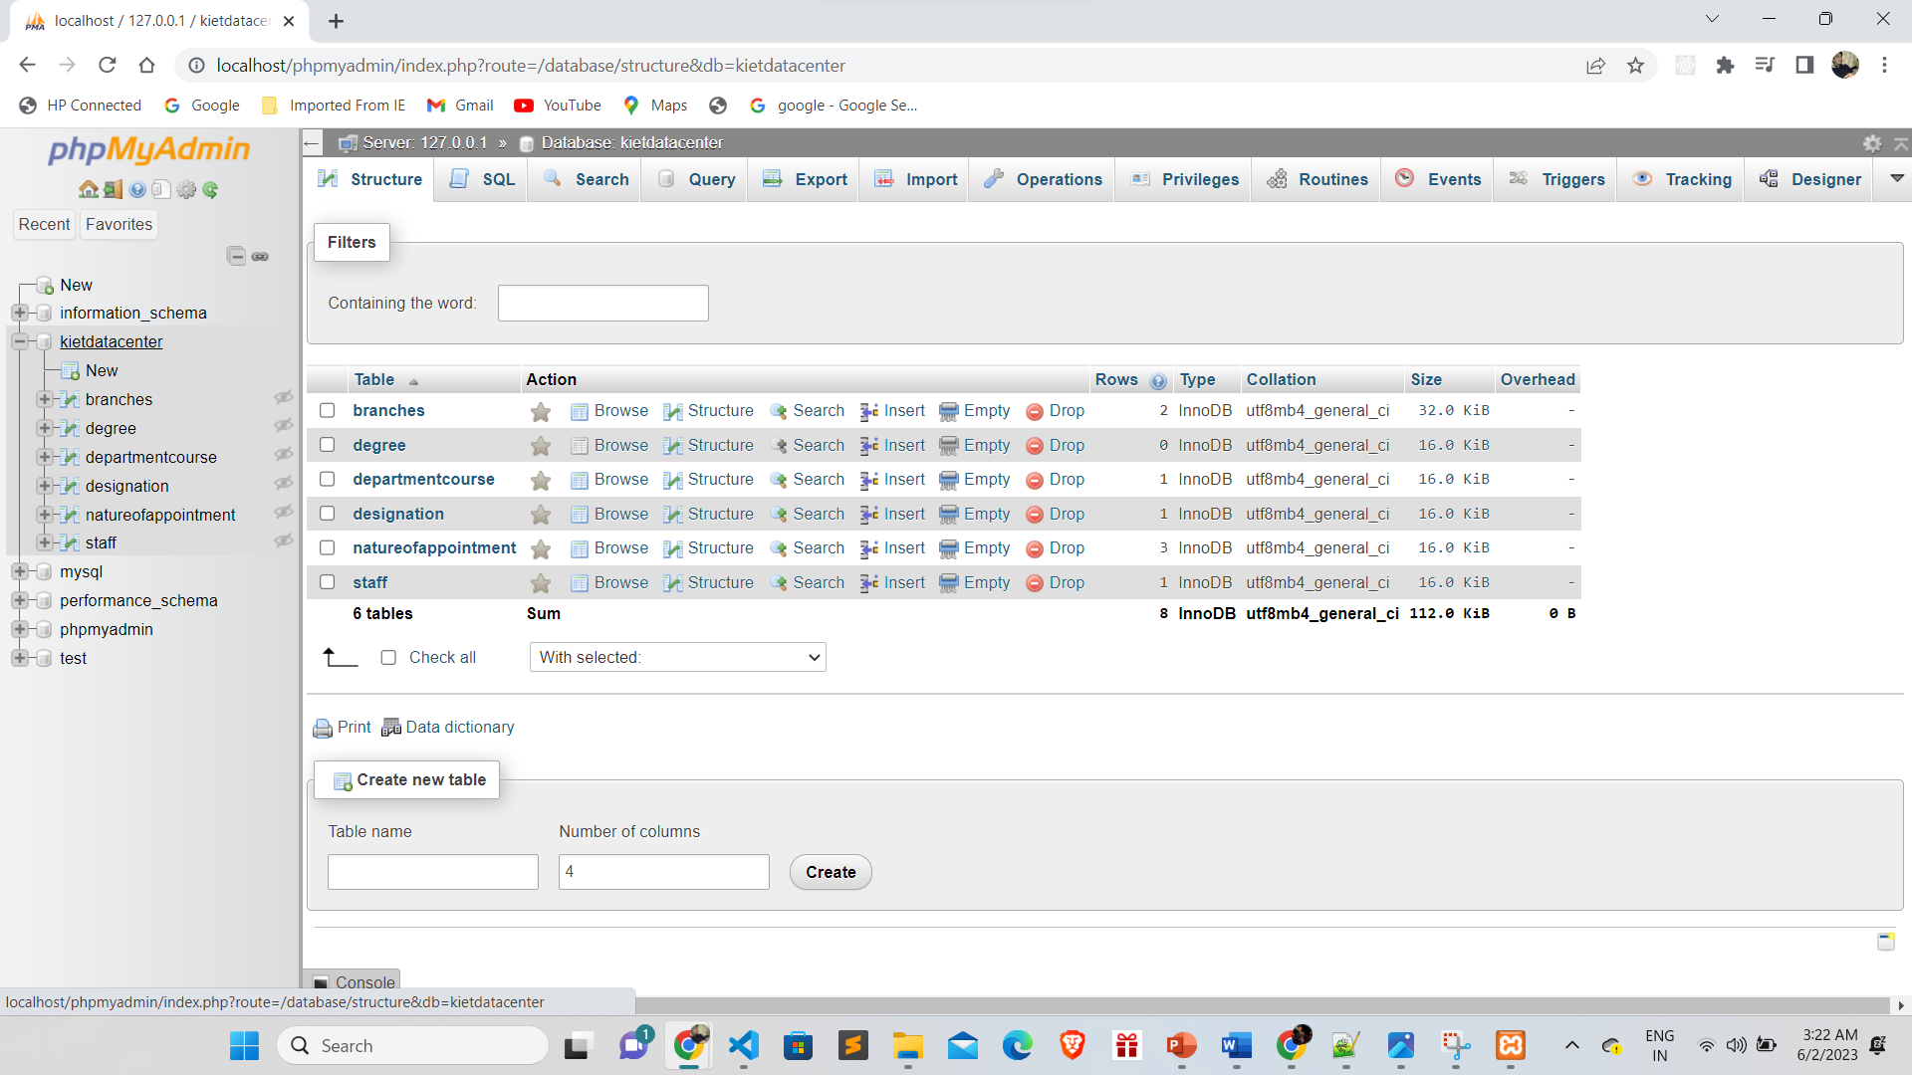
Database

Slide 14
Future Enhancement
Mobile Application: Develop a mobile application that allows students, faculty, and staff to access key features of the database management system on their mobile devices. This would provide convenience and accessibility for users who are constantly on the move.
Analytics and Predictive Modeling: Develop advanced analytics and predictive modeling capabilities within the system. This would enable administrators and faculty to gain insights into student performance, predict enrollment trends, and make data-driven decisions.
When planning for future enhancements, it is important to engage stakeholders, including college administrators, faculty, staff, and students, to gather feedback and prioritize the most valuable features and functionalities that align with the college's goals and evolving needs.

Slide 15
Project Outcome
Easy to extract the information about upcoming decisions from higher authorities. Automate the process of information transfer between departments to save time with respect to deadline.
Easy access to information: KIET data center can make it easy for college officials to extract information about upcoming decisions from higher authorities. By storing all relevant data in a centralized database, administrators and other department can quickly access the information they need to make informed decisions. This can lead to faster decision-making and more efficient operations.
Automation of data transfer: KIET data center can process the information of transfer between departments. This can save time and ensure that deadlines are met. For example, if one department needs to share data with another department to complete a task. This can reduce the risk of errors and delays, leading to more efficient operations and better outcomes.

Slide 16
Conclusion
In conclusion, the management of college and department databases plays a crucial role in the efficient operation of educational institutions. This project aims to develop and implement a comprehensive database management system that covers various aspects, including student certificates, academic details, event information, account department records, human resources department records, and student placements in organizations.
By implementing this system, the college will benefit from improved data management processes, streamlined workflows, and enhanced decision-making capabilities. The system will enable easy access to information, facilitate efficient updating and editing of records, and ensure proper resource management of college data. This, in turn, will lead to improved services for students, faculty, and staff.
Overall, this project will provide a comprehensive and efficient database management system for the college, leading to improved data management, streamlined processes, and better services for all stakeholders. It will enhance the institution's reputation as a leading educational establishment and contribute to its overall success and growth.

Slide 17
THANKYOU

